Slide 1
Chapter 2:
System Structures

Slide 2
Chapter 2: System Structures
Operating System Services
User Operating System Interface
System Calls
Types of System Calls
System Programs (compiler linker loader)
Operating System Design and Implementation
Operating System Structure(linux windows 不同OS有不同結構)
Virtual Machines(在一台機器硬體跑很多台虛擬機器和不同OS 但每一台虛擬機使用時感覺都是這台電腦上專用的)
Operating System Debugging
Operating System Generation
System Boot
Notes:
Operating System Generation 怎麼產生OS 會跟HW有關 有幾個CPU 裡面幾個Core 給你不同硬體環境 怎麼設計OS需要含哪些部份 把需要的模組組織起來 總是要產一個OS啊 把模組結合起來 不需要的模組拿掉 怎麼客製化 (同下頁) 手機硬體有觸控螢幕 硬碟記憶體都小 就要不同設計的OS 接著是System Boot 怎麼啟動執行OS

Slide 3
Objectives
To describe the services an operating system provides to users, processes, and other systems
To discuss the various ways of structuring an operating system
To explain how operating systems are installed and customized and how they boot

Slide 4
Operating System Services
One set of operating-system services provides functions that are helpful to the user:
  User interface - Almost all operating systems have a user interface (UI)
    Varies between Command-Line (CLI), Graphics User Interface (GUI), Batch(大量程式需要被執行 丟進Batch一個個run)
  Program execution - The system must be able to load a program into memory and to run that program, end execution, either normally or abnormally (indicating error) 執行成功/發生錯誤
  I/O operations - A running program may require I/O, which may involve a file or an I/O device 網路 螢幕滑鼠都算
  File-system manipulation - The file system is of particular interest. Obviously, programs need to read and write files and directories, create and delete them, search them, list file Information, permission management.
Notes:
1-2

Slide 5

A View of Operating System Services

Slide 6
Operating System Services (Cont)
One set of operating-system services provides functions that are helpful to the user (Cont):
  Communications – Processes may exchange互相交換資料 information, on the same computer or between computers over a network
    Communications may be via shared memory or through message passing (packets封包 moved by the OS)
  Error detection – OS needs to be constantly aware of possible errors
    May occur in the CPU and memory hardware, in I/O devices, in user program
    For each type of error, OS should take the appropriate action to ensure correct and consistent computing
    Debugging facilities(能力 工具) can greatly enhance the user’s and programmer’s abilities to efficiently use the system

Slide 7
Operating System Services (Cont)
Another set of OS functions exists for ensuring the efficient operation of the system itself via resource sharing
  Resource allocation - When multiple users or multiple jobs running concurrently, resources must be allocated to each of them
    Many types of resources - Some (such as CPU cycles, main memory, and file storage) may have special allocation code, others (such as I/O devices) may have general request and release code
  Accounting - To keep track of which users use how much and what kinds of computer resources
Notes:
1-2

Slide 8
Operating System Services (Cont)
Protection and security - The owners of information stored in a multiuser or networked computer system may want to control use of that information, concurrent processes should not interfere妨礙衝突 with each other
  Protection involves ensuring that all access to system resources is controlled
  Security of the system from outsiders require user authentication, extends to defending external I/O devices from invalid無效/不合法 access attempts
  If a system is to be protected and secure, precautions預防警惕 預警 ex密碼錯誤發信 有人在錯誤嘗試你的帳號 三次鎖住must be instituted設立規則 throughout it. A chain is only as strong as its weakest link.

Slide 9
User Operating System Interface - CLI
Command Line Interface (CLI) or command interpreter allows direct command entry
    Some Operating Systems include the command interpreter(解釋 解析指令 直譯器) in the kernel(OS的核心) 認識指令 指令動作寫死內建在interprter裡面.
    優點執行快 不用再去載入其他程式
    Others (Windows XP and UNIX) treat the command interpreter as a special program that is running when a job is initiated. On systems with multiple command interpreters to choose them, the interpreters are known as shells(殼 把OS核心包起來). 寫在備註
    On UNIX and LINUX, a user may choose among several different shells, including Bourne shell, C shell, Bourne-Again shell, Korn shell, and others.
    Most shells provide similar functionality, and a user’s choice of which shell is personal preference.
Notes:
Others (Windows XP and UNIX) treat the command interpreter as a special program that is running when a job is initiated. 不認識指令 指令對應的程式可更新 interprter本身不用修改
每套command interpreter都認識一套指令 用不同comd intp 可下不同指令

Slide 10
User Operating System Interface - CLI
The main function of the command interpreter is to get and execute the next user-specified command.
Most manipulate files: create, delete, copy, list, execute,…
These commands can be implemented by two ways.
The command interpreter itself contains the code to execute the command. 法一
An alternative approach (used by UNIX) implements most commands through system programs. The command interpreter does not understand the command, it uses the command to identify a file(例如rm.exe) to be loaded into memory and executed. 法二
UNIX command to delete a file
  rm file.txt
Notes:
1-2

Slide 11
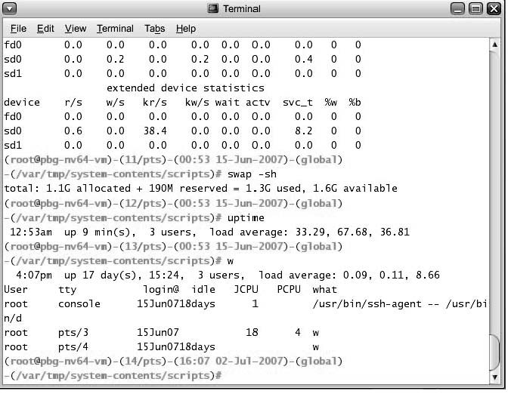
Bourne Shell Command Interpreter
Bourne Shell Command Interpreter in Solaris(昇陽的OS 最近更新2018) 10

Slide 12
User Operating System Interface - GUI
User-friendly desktop interface
  Usually mouse, keyboard, and monitor
  Icons represent files, programs, actions, etc
  Various mouse buttons over objects in the interface cause various actions (provide information, options, execute function, open directory (known as a folder))
  Invented at Xerox PARC (in 1970s)
Many systems now include both CLI and GUI interfaces
  Microsoft Windows is GUI with CLI “command” shell
  Apple Mac OS X as “Aqua水綠色” GUI interface with UNIX kernel underneath and shells available
  Solaris is CLI with optional GUI interfaces (Java Desktop)

Slide 13

The Mac OS X GUI

Slide 14
System Calls
Programming interface to the services provided by the OS
Typically written in a high-level language (C or C++)
Mostly accessed by programs via a high-level Application Program Interface (API) rather than direct system call use
Three most common APIs are
  Win32 API for Windows,
  POSIX API for POSIX-based systems (including virtually all versions of UNIX, Linux, and Mac OS X), and
  Java API for the Java virtual machine (JVM)
Why use APIs rather than system calls?
(Note that the system-call names used throughout this text are generic)
Notes:
high-level Application Program Interface (API) 把多個最基礎的操作 組合成一個高階一點的操作提供使用 很像是library的概念 下頁

Slide 15

Example of System Calls
System call sequence to copy the contents of one file to another file
Notes:
很像是C# fileStream的寫法

Slide 16

Example of Standard API
Consider the ReadFile() function in the Win32 API—a function for reading from a file
A description of the parameters passed to ReadFile()
  HANDLE file—the file to be read
  LPVOID buffer—a buffer where the data will be read into and written from
  DWORD bytesToRead—the number of bytes to be read into the buffer
  LPDWORD bytesRead—the number of bytes read during the last read
  LPOVERLAPPED ovl—indicates if overlapped I/O is being used
Notes:
跟我在寫wave process的時候很像 Naudio 就是傳這些參數 概念和參數完全一樣 還有回傳bool 成功失敗 不過我寫C#看Wei這樣寫 都覺得有點多餘 靠throw Exception比較簡單處理 整個架構簡單很多 錯誤訊息也好傳 可見底層和上層的寫法概念還是有差

Slide 17
System Call Implementation
Typically, a number associated with each system call
  System-call interface maintains a table indexed according to these numbers
The system call interface invokes intended system call in OS kernel and returns status of the system call and any return values
The caller need know nothing about how the system call is implemented
  Just needs to obey API and understand what OS will do as a result call
  Most details of OS interface hidden from programmer by API
    Managed by run-time support library (set of functions built into libraries included with compiler)
Notes:
ok 同我的實務經驗

Slide 18

API – System Call – OS Relationship

Slide 19

Standard C Library Example
C program invoking printf() library call, which calls write() system call

Slide 20
System Call Parameter Passing
Often, more information is required than simply identity of desired system call
  Exact type and amount of information vary according to OS and call
Three general methods used to pass parameters to the OS
  Simplest: pass the parameters in registers
    In some cases, may be more parameters than registers
  Parameters stored in a block, or table, in memory, and address of block passed as a parameter in a register
    This approach taken by Linux and Solaris
  Parameters placed, or pushed, onto the stack by the program and popped off the stack by the operating system
  Block and stack methods do not limit the number or length of parameters being passed
  > ok就參數傳遞給sys call的方式 一個個reg 或更多block in mem+address 或stack
Notes:
stack pointer 放在stack最頂端的地方 一直push超故容量 就會stack overflow 一個區塊程式結束時，pushpop最終的兩個總和數量要相等 才不會每次都留一些資料沒pop 也算是mem leak 累積久了爆掉就會當機 這種情況發生不容易找出原因 通常執行一段時間才突然蹦出來 不像是一般Exception 直接馬上出現 例如跑三個月才能重現
所以相關程式段最後return的時候 要把stack清空

Slide 21

Parameter Passing via Table
x
Table
Notes:
參數放到記憶體的一個區塊 起始位置叫x 把x放到reg 再呼叫system call 就可以傳大量參數

Slide 22
Types of System Calls
Process control
File management
Device management
Information maintenance
Communications
Protection
Notes:
6種system call

Slide 23

Examples of Windows and Unix System Calls
Notes:
Ok 一半在C# 用過類似的 fork!!!! Wait 可能一個process再等另一個process的執行結果 或傳一個參數給他 通常叫做signal的方式來通知

Slide 24

MS-DOS execution
(a) At system startup (b) running a program
Notes:
Start up 開機之後 會有一個kernel透過bootstrap從硬碟搬到記憶體 早期的MS-DOS沒辦法multi programming 只能放單支程式如圖 算是早期初淺簡單版的程式

Slide 25

FreeBSD Running Multiple Programs
Notes:
後來的FreeBSD就可以跑好幾隻 一隻在等IO的時候 就可以執行其他支 process叫做 IO bound > 大部分在做IO 像是online game process 叫 CPU bound > 大部分在做計算 例如矩陣運算 不做IO 2-6

Slide 26
System Programs
System programs provide a convenient environment for program development and execution. They can be divided into: 就是幫助開發者開發的一些輔助程式
  File manipulation
  Status information
  File modification
  Programming language support
  Program loading and execution
  Communications
  Application programs
Most users’ view of the operation system is defined by system programs, not the actual system calls
Notes:
像是compiler就是 系統程式 如果是組合語言 會有assembler 也是系統程式 一支程式會呼叫很多Library 要再包進來 或是寫程式的時候不是寫一大塊程式 而是寫成一塊塊小的模組 分別compiler 因為模組之間有呼叫 所以要由linker 再合併起來成一個大的 包成一大包之後 是可以執行的code 叫做object code
另外因為 程式搬到記憶體 每次搬進去的未只可能都不一樣 所以位址的描述都要用相對位址的概念 loader設幫忙修正程式一些基礎項目 例如幫你把絕對位址改成相對位址 還有決定各個程式要放記憶體哪個位址

Slide 27
System Programs
File management - Create, delete, copy, rename, print, dump, list, and generally manipulate files and directories
Status information
  Some ask the system for info - date, time, amount of available memory, disk space, number of users
  Others provide detailed performance, logging, and debugging information
  Typically, these programs format and print the output to the terminal or other output devices
  Some systems implement a registry註冊處 - used to store and retrieve configuration information regedit?
Notes:
ok

Slide 28
System Programs (cont’d)
File modification
  Text editors to create and modify files
  Special commands to search contents of files or perform transformations of the text
Programming-language support - Compilers, assemblers, debuggers and interpreters sometimes provided
Program loading and execution- Absolute loaders, relocatable loaders, linkage editors, and overlay-loaders, debugging systems for higher-level and machine language
Communications - Provide the mechanism for creating virtual connections among processes, users, and computer systems
  Allow users to send messages to one another’s screens, browse web pages, send electronic-mail messages, log in remotely, transfer files from one machine to another
Notes:
interpreter直譯器 直接翻譯 system program 也是歸 OS 管 OS也管CPU mem compiler是先把高階語言翻成機器語言 然後再經過linker lloader執行 interpreter是直接接到command或一看語言就直接執行 不翻成object code object code是可執行的程式碼 但是還要靠loader搬到記憶體
寫組合語言 第一行要寫org 就是指定這支程式要放到哪個位址
Linkage editor 如果寫程式的時候 引用一堆沒用到的library 如果建置的時候真的都包進程式 就會佔很多空間又根本不會用到裡面的東西 linkage editor可以幫忙改機制不直接全包進來 等到發現真的程式碼呼叫到的時候才包那個library進來

Slide 29
In computer science, an interpreter is a computer program that directly executes instruction
ns written in a programming or scripting language, without requiring them previously to have been compiled into a machine language program. An interpreter generally uses one of the following strategies for program execution:
Parse the source code and perform its behavior directly;
Translate source code into some efficient intermediate representation and immediately execute this;
Explicitly execute stored precompiled code^{[1]} made by a compiler which is part of the interpreter system.
Notes:
https://en.wikipedia.org/wiki/Interpreter_(computing)

Slide 30
Programs written in a high level language are either directly executed by some kind of interpreter or converted into machine code by a compiler (and assembler and linker) for the CPU to execute.
While compilers (and assemblers) generally produce machine code directly executable by computer hardware, they can often (optionally) produce an intermediate form called object code. This is basically the same machine specific code but augmented with a symbol table with names and tags to make executable blocks (or modules) identifiable and relocatable. Compiled programs will typically use building blocks (functions) kept in a library of such object code modules. A linker is used to combine (pre-made) library files with the object file(s) of the application to form a single executable file. The object files that are used to generate an executable file are thus often produced at different times, and sometimes even by different languages (capable of generating the same object format).
A simple interpreter written in a low level language (e.g. assembly) may have similar machine code blocks implementing functions of the high level language stored, and executed when a function's entry in a look up table points to that code. However, an interpreter written in a high level language typically uses another approach, such as generating and then walking a parse tree, or by generating and executing intermediate software-defined instructions, or both.
Thus, both compilers and interpreters generally turn source code (text files) into tokens, both may (or may not) generate a parse tree, and both may generate immediate instructions (for a stack machine, quadruple code, or by other means). The basic difference is that a compiler system, including a (built in or separate) linker, generates a stand-alone machine code program, while an interpreter system instead performs the actions described by the high level program.
A compiler can thus make almost all the conversions from source code semantics to the machine level once and for all (i.e. until the program has to be changed) while an interpreter has to do some of this conversion work every time a statement or function is executed. However, in an efficient interpreter, much of the translation work (including analysis of types, and similar) is factored out and done only the first time a program, module, function, or even statement, is run, thus quite akin to how a compiler works. However, a compiled program still runs much faster, under most circumstances, in part because compilers are designed to optimize code, and may be given ample time for this. This is especially true for simpler high level languages without (many) dynamic data structures, checks, or type-checks.
Notes:
https://en.wikipedia.org/wiki/Interpreter_(computing)

Slide 31
Operating System Design and Implementation
No complete solutions to design and Implement of OS, but some approaches have proven successful 和硬體環境需求都有關而不同
Internal structure of different Operating Systems can vary widely
Start by defining goals and specifications
Affected by choice of hardware, type of system
User goals and System goals
  User goals – operating system should be convenient to use, easy to learn, reliable, safe, and fast
  System goals – operating system should be easy to design, implement, and maintain, as well as flexible, reliable, error-free, and efficient

Slide 32
Operating System Design and Implementation (Cont)
Important principle to separate
Policy: What will be done ?
Mechanism: How to do it ?
Mechanisms determine how to do something, policies decide what will be done
  The separation of policy from mechanism is a very important principle, it allows maximum flexibility if policy decisions are to be changed later

Slide 33
Simple Structure
MS-DOS – written to provide the most functionality in the least space
  Not divided into modules
  Although MS-DOS has some structure, its interfaces and levels of functionality are not well separated

Slide 34

MS-DOS Layer Structure
Notes:
Resident 定居 內在 BIOS通常處理最基本的IO mouse keyboard hraddisk 等等 device driver有點像是kernel 前面說的system program : compiler

Slide 35

Traditional UNIX System Structure
Notes:
第二層是 system program層 第三層是kernel system program要做比較底層的動作 就要用system call呼叫Kenel層的程式 (例如p18)

Slide 36
UNIX
UNIX – also limited by hardware functionality, the original UNIX OS had limited structuring.
The UNIX OS consists of two separable parts
  System programs
  The kernel
    Consists of everything below the system-call interface and above the physical hardware
    Provides the file system, CPU scheduling, memory management, and other OS functions; a large number of functions for one level

Slide 37
Layered Approach
The operating system is divided into a number of layers (levels), each built on top of lower layers.一層層疊上去 跟dll reference概念很像 The bottom layer (layer 0), is the hardware; the highest (layer N) is the user interface.
With modularity, layers are selected such that each uses functions (operations) and services of only lower-level layers\
Notes:
為了讓設計更有彈性 用Layer分層的概念 去設 Module就是一般的模組化 拆成小模組要新增或修改什麼方法 就只要替換那個小區塊就可以了 不用整個大程式去修改建置 分工也比較好分 要拆出來或是組合也簡單

Slide 38

Layered Operating System
Notes:
一層層 ex Layer1 driver Layer2 system program Layer3 application program

Slide 39
Microkernel System Structure
Moves as much from the kernel into “user” space
Communication takes place between user modules using message passing
Benefits:
  Easier to extend a microkernel
  Easier to port the operating system to new architectures
  More reliable (less code is running in kernel mode)
  More secure 小而美
Detriments損傷:
  Performance overhead of user space to kernel space communication
Notes:
例如在記憶體很小 CPU也不強的環境 就用micro kernel 會比較適合 句1.把kernel的一些功能移到user space message passing: Kernel層和 User層 之間的資料傳遞 把資料打包傳遞 因為本來都在kernel 如果有搬一些到user 就變成需要溝通的更多

Slide 40
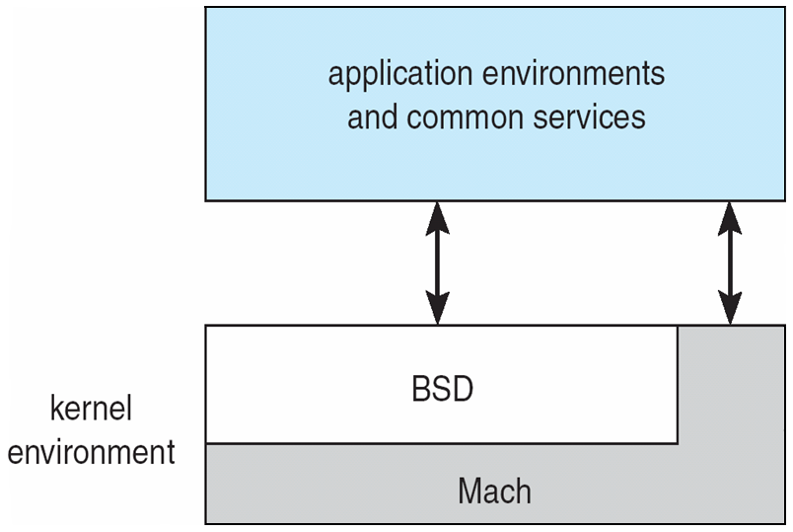
Mac OS X Structure
Notes:
Mach 馬赫 不過應該是 Mach Hardware

Slide 41
Modules
Most modern operating systems implement kernel modules
  Uses object-oriented approach
  Each core component is separate
  Each talks to the others over known interfaces
  Each is loadable as needed within the kernel
Overall, similar to layers but with more flexible
Notes:
現在最新的OS設計方法 用kernel modules

Slide 42

Solaris Modular Approach
Notes:
核心是kernel 外面是各模組

Slide 43

Virtual Machines
A virtual machine takes the layered approach to its logical conclusion. It treats hardware and the operating system kernel as though they were all hardware
A virtual machine provides an interface identical to the underlying bare hardware
The operating system host creates the illusion that a process has its own processor and (virtual memory)
Each guest provided with a (virtual) copy of underlying computer

Slide 44
Virtual Machines History and Benefits
First appeared commercially in IBM mainframes(大型主機) in 1972
Fundamentally, multiple execution environments (different operating systems) can share the same hardware 希望同個hardware上有不同的執行環境 和OS 可以跑
Protect from each other
Some sharing of file can be permitted, controlled
Commutate方向轉換/整流 with each other, other physical systems via networking
Useful for development, testing
Consolidation 強化 of many low-resource use systems onto fewer busier systems 散在各個server功耗小的程式 集中到一台跑只要一台
“Open Virtual Machine Format”, standard format of virtual machines, allows a VM to run within many different virtual machine (host) platforms
Notes:
Java也是一種virtual machine的概念 讓你在不同平台run

Slide 45
Virtual Machines (Cont)
(a) Nonvirtual machine (b) virtual machine
Non-virtual Machine
Virtual Machine
Notes:
如果越多個VM run在 同一個hardware 那每一台的效能就會變差 因為hradware資源是相同的 右邊三個紅框相當於三個vm 紅框底下好像模擬了kernel 和 VM1(有點hradware的感覺) 電腦本身的OS 叫做Host 上面跑的vm叫做guest

Slide 46
Para-virtualization
Presents guest with system similar but not identical to hardware 提供guest的機制類似但不是完全相同於HW
部分虛擬化的意思 para是類似的字頭
Guest must be modified to run on paravirtualized hardware
Guest can be an OS, or in the case of Solaris 10 applications running in containers

Slide 47
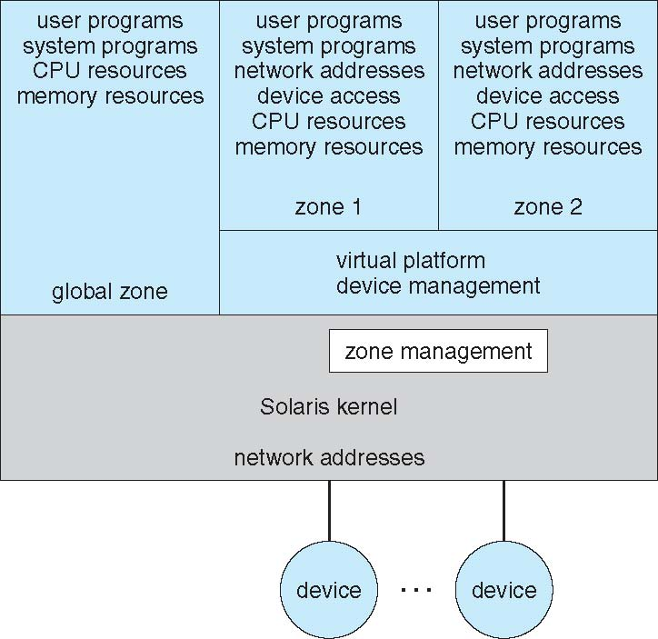
Solaris 10 with Two Containers
Notes:
上面兩個紅框叫做container 類似vm只是不同名稱 zone1 2裡面有多種resource 就是列的那些 幾乎等同於電腦了 實際上還是用下面硬體的資源

Slide 48
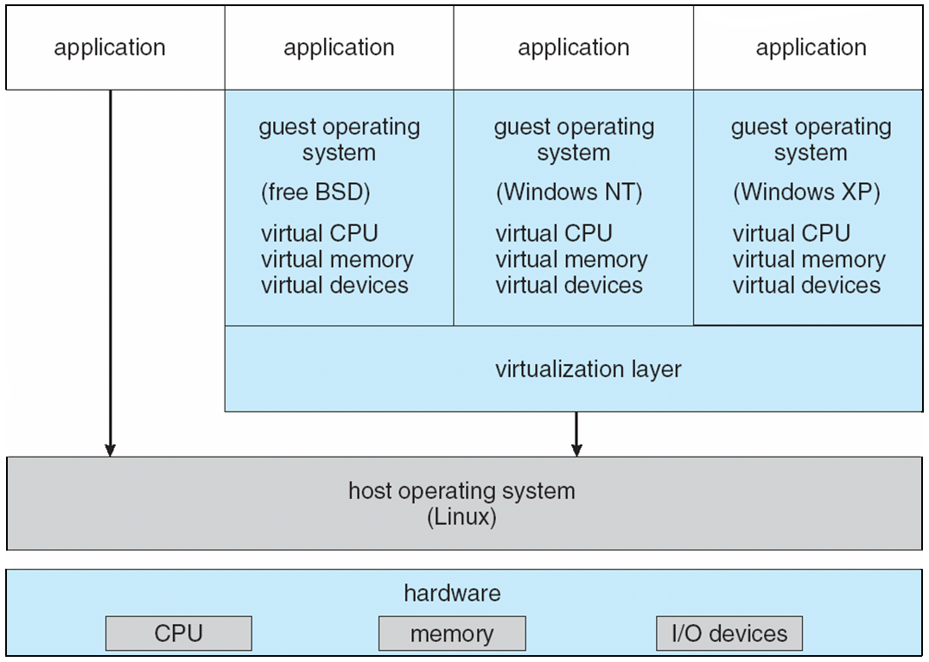
VMware Architecture
Notes:
知名VM廠 有名價格高 很多大公司用他們的服務 host選用linux 上面紅框可以跑數至數十個VM

Slide 49
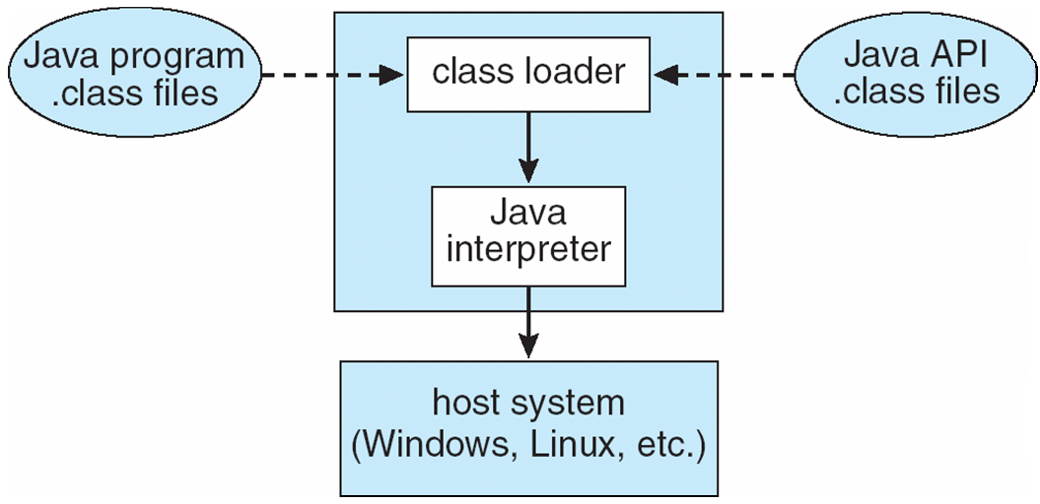
The Java Virtual Machine
Notes:
Java interpreter 會看你現在在哪個OS 呼叫不同system call

Slide 50
Operating-System Debugging
Debugging is finding and fixing errors, or bugs
OSes generate log files containing error information
Failure of an application can generate core dump file capturing memory of the process
Operating system failure can generate crash dump file containing kernel memory
Beyond crashes, performance tuning can optimize system performance
Kernighan’s Law: “Debugging is twice as hard as writing the code in the ﬁrst place. Therefore, if you write the code as cleverly as possible, you are, by deﬁnition, not smart enough to debug it.”
DTrace tool in Solaris, FreeBSD, Mac OS X allows live instrumentation儀器/器具 on production systems
  Probes fire when code is executed, capturing state data and sending it to consumers of those probes

Slide 51

Solaris 10 dtrace Following System Call

Slide 52
Operating System Generation
Operating systems are designed to run on any of a class of machines; the system must be configured for each specific computer site
SYSGEN program obtains information concerning the specific configuration of the hardware system
Booting – starting a computer by loading the kernel
Bootstrap program – code stored in ROM that is able to locate the kernel, load it into memory, and start its execution
Notes:
SYSGEN 產生OS的程式 先提供HW的相關資訊做成參數檔 傳給SYSGEN SYSGEN就會自動判斷目前的HW那些模組要拉進來 那些拿掉不使用

Slide 53
System Boot
Operating system must be made available to hardware so hardware can start it
  Small piece of code – bootstrap loader, locates the kernel, loads it into memory, and starts it
  Sometimes two-step process where boot block at fixed location loads bootstrap loader
  > bootstrap loader變小 原本的程式部分放到disk 開機時多一步 1 先載入boostrap loader 2 執行bootstrap loader
  When power initialized on system, execution starts at a fixed memory location
    Firmware used to hold initial boot code
Notes:
Bootstrap loader 負責把整個OS載入 開機/Reset鍵按下去 就是到固定位址執行bootstrap loader 載入kernel 開機呼叫的最開始的程式 一定是燒死在某個硬體的一個區塊(師這裡沒說 前面好像說是ROM)

Slide 54
End of Chapter 2

